Slide 1
Data Product Manager Nanodegree
Applying Data Science to Product Management
Final Project: Developing an MVP Launch Strategy for a Flying Taxi Service

Slide 2
Welcome to your first week at Flyber

Slide 3


Slide 4
In this project, you will apply the skills acquired in this course to create the MVP launch strategy for the first flying car taxi service, Flyber, in one of the most congested cities in America -- New York City.
You are responsible for bringing the first flying car taxi service to market by analyzing data and building a product proposal.

Slide 5
You will need to use the SQL workspace provided in the Classroom, and Tableau Public, in order to successfully complete the project.
You’ll present your answers, findings, and insights in the Answer Slides found in this deck. Feel free to include any additional slides, if needed.

Slide 6
Section 1: Data Exploration

Slide 7
Back to the basics of product management, identify your customer and their pain points:
What are taxis used for?
What are the characteristics of the users that leverage them?
What are existing pain points with taxis?
What are the existing pain points with digital ride-sharing services?

Slide 8
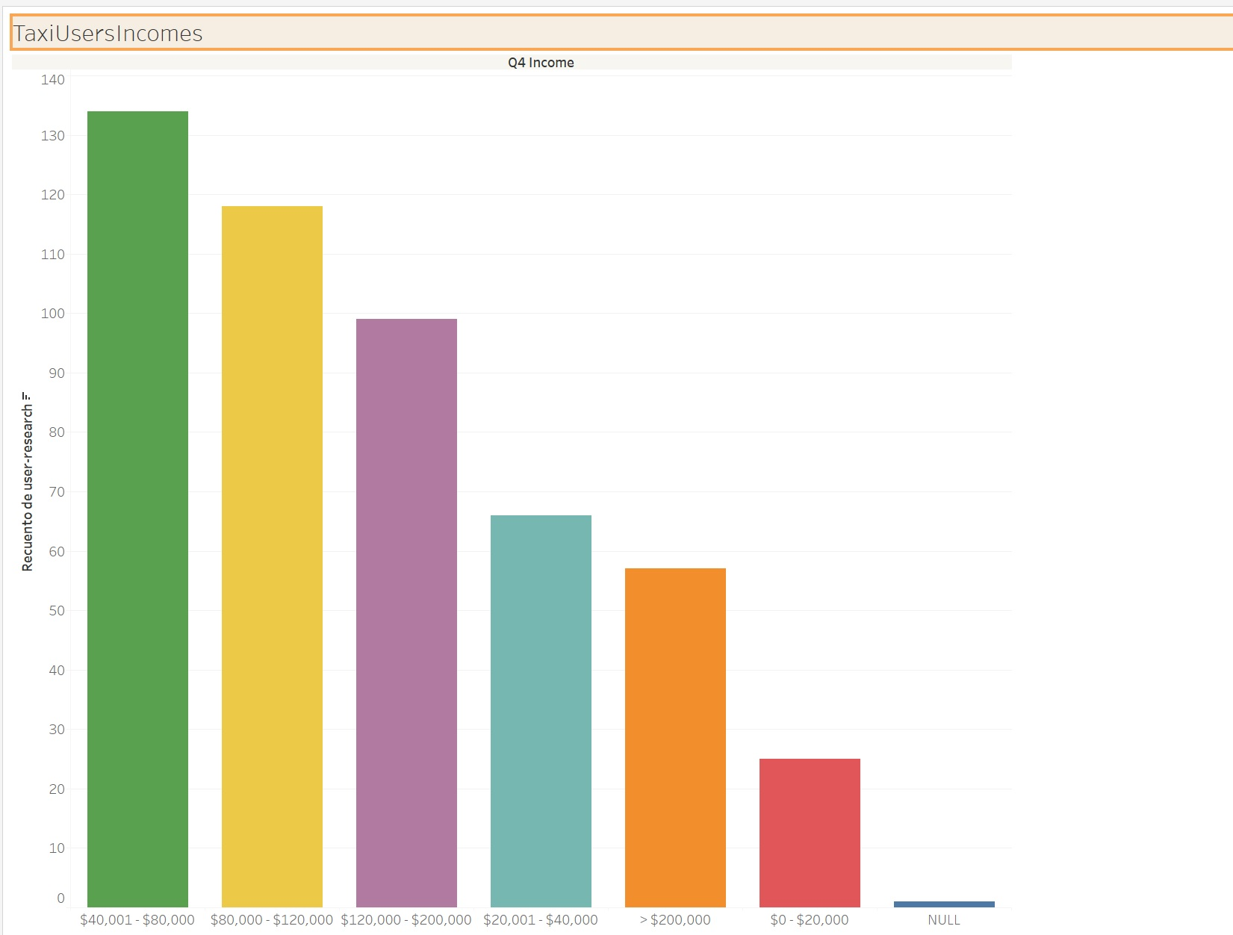
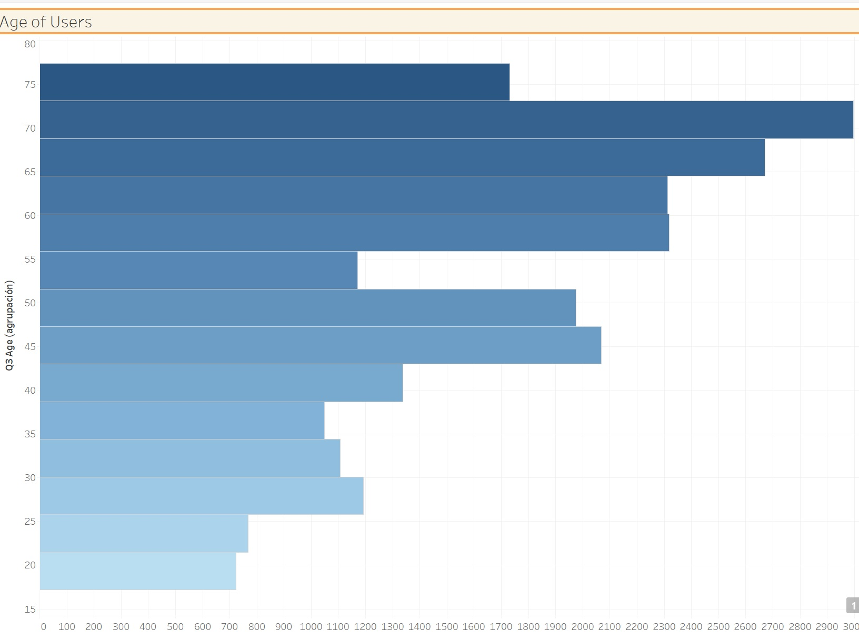
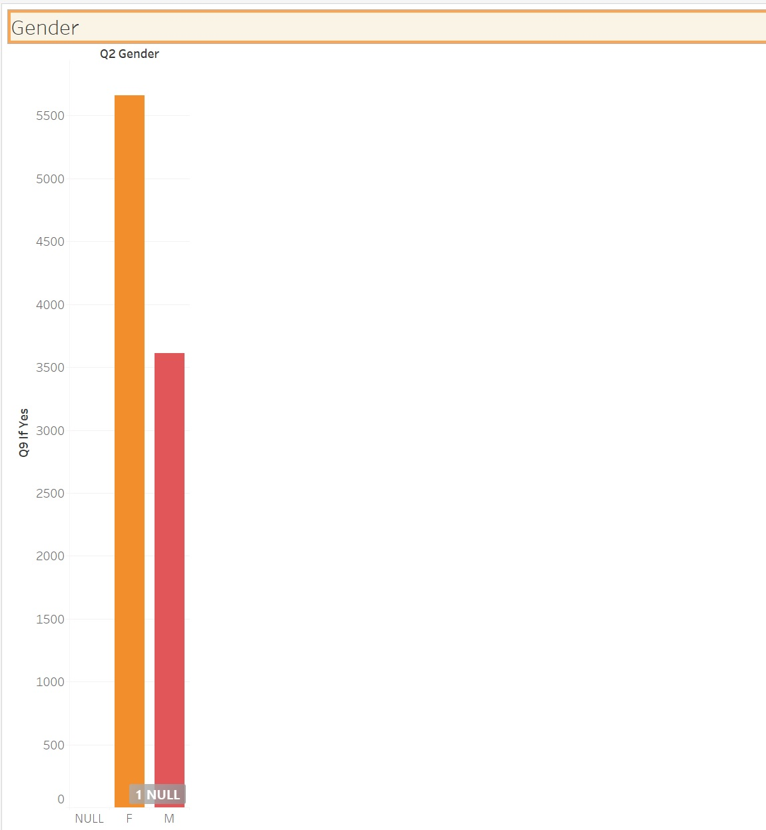
Answer Slide
(Fill out your answer here)

Slide 9
What user improvements do you hypothesize a flying taxi service would have over the existing state of taxis today?
What market improvements do you hypothesize a flying taxi service would have the existing taxi service industry & physical road infrastructure today?

Slide 10
Answer Slide
* Faster Services by the Taxi as there wont be traffic congestion, having all routes empty of spaces for going everywhere. * Less polution on atmosphere because these new flying taxis will be electrical * Less murders and steals committed to the taxi drivers. * No need to parked them, easing the free space on the streets for cars. * No light regulation and police control expenses to be spent on them. * No need for streets to be cleaned and saving costs for this reason.

Slide 11
Upload this dataset into Tableau Online.
Ensure the fields are parsed correctly; field headers are included in the first row of the CSV. Let’s begin exploration!

Slide 12
Acquire a high-level understanding of the granularity and scope of the dataset, to inform the basis for your analyses:
How many records are in the dataset
What does each record represent?
What is the primary key?
What date range is your dataset bound to?
What are the geographical bounds of this dataset? Is it limited to Manhattan, or is Brooklyn, Queens, Staten Island, the Bronx, and New Jersey included? Where are most of the data points centralized at? Are there outliers?

Slide 13
Answer Slide
- Records in the data set: 1,048,468 - What does each record represent? Data from a taxi ride of a user. - Primary Key: Q1_email(user_research) / id (taxirides) - Data setbound: New York, USA, streets.
- Limits of New York city: Latitude – 40.71427, Longitude – 74.00597 - Where are the most of the data points centralized at? Midtown, Bakery Park city, Tribeca, Financial District, Turtle Bay.

Slide 14
You notice that the dataset does not contain explicit data points out-of the-box, we’ll need to enrich the dataset with relevant fields:
You notice that ride price is not included, but figure it could be derived. Based on information about New York taxi prices gleaned from the internet, create a calculated field called `price` using the `duration`, `distance`, and `passenger count` fields.
You hypothesize your target users will be those who take a relatively longer time getting to a destination that is relatively close, due to heavy traffic conditions and/or limitations to physical road infrastructure. To be able to analyze where this is happening, you will need to create a calculated field called `distance-to-duration ratio`.

Slide 15
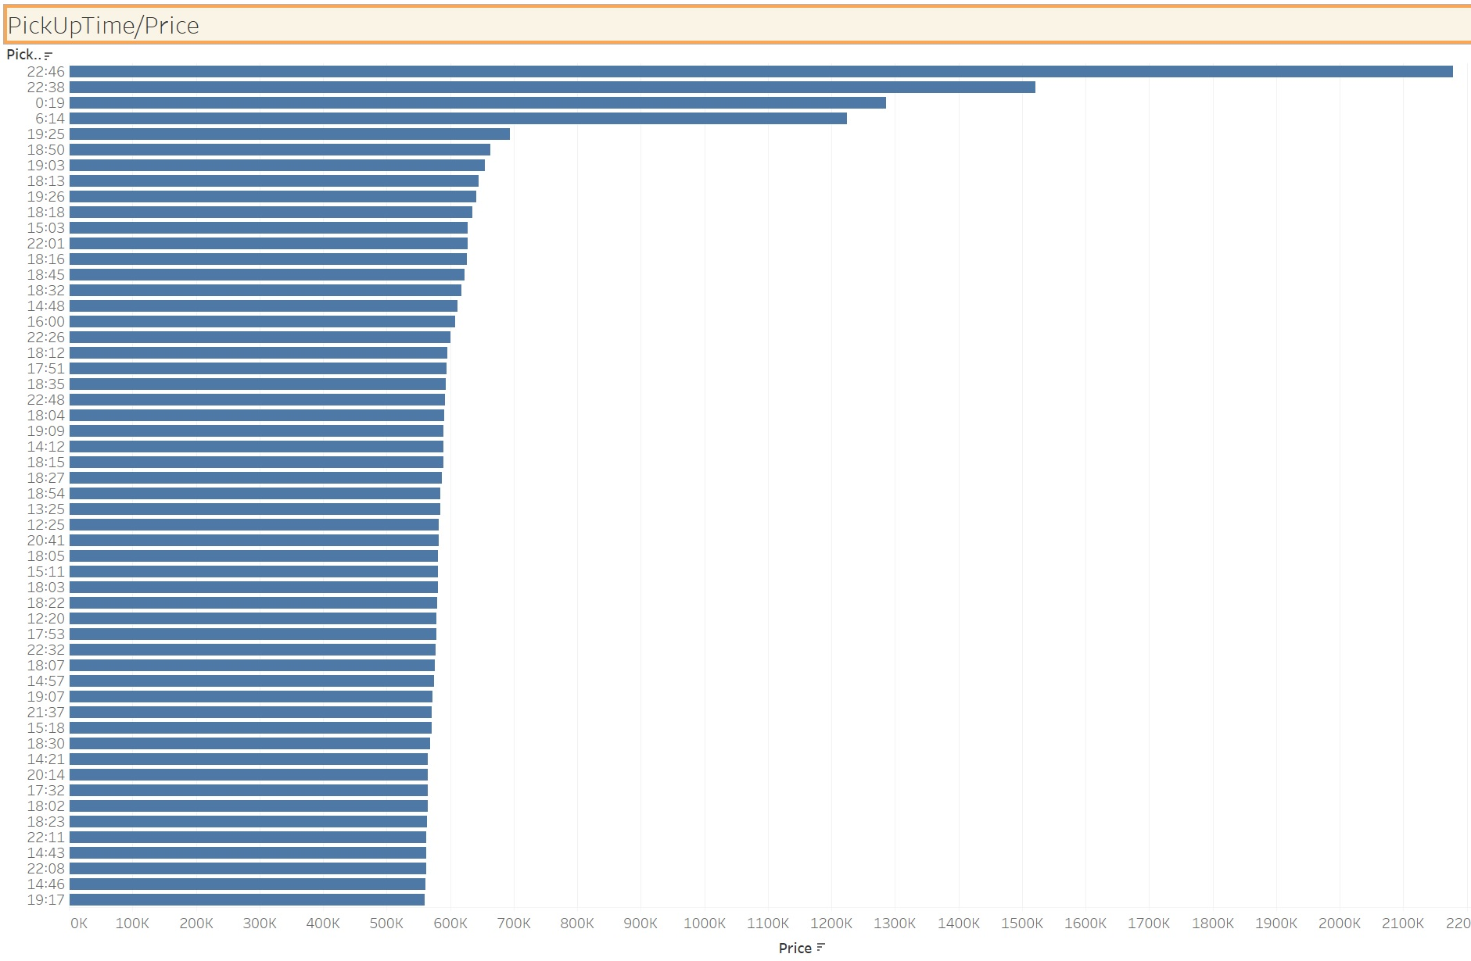

Slide 16
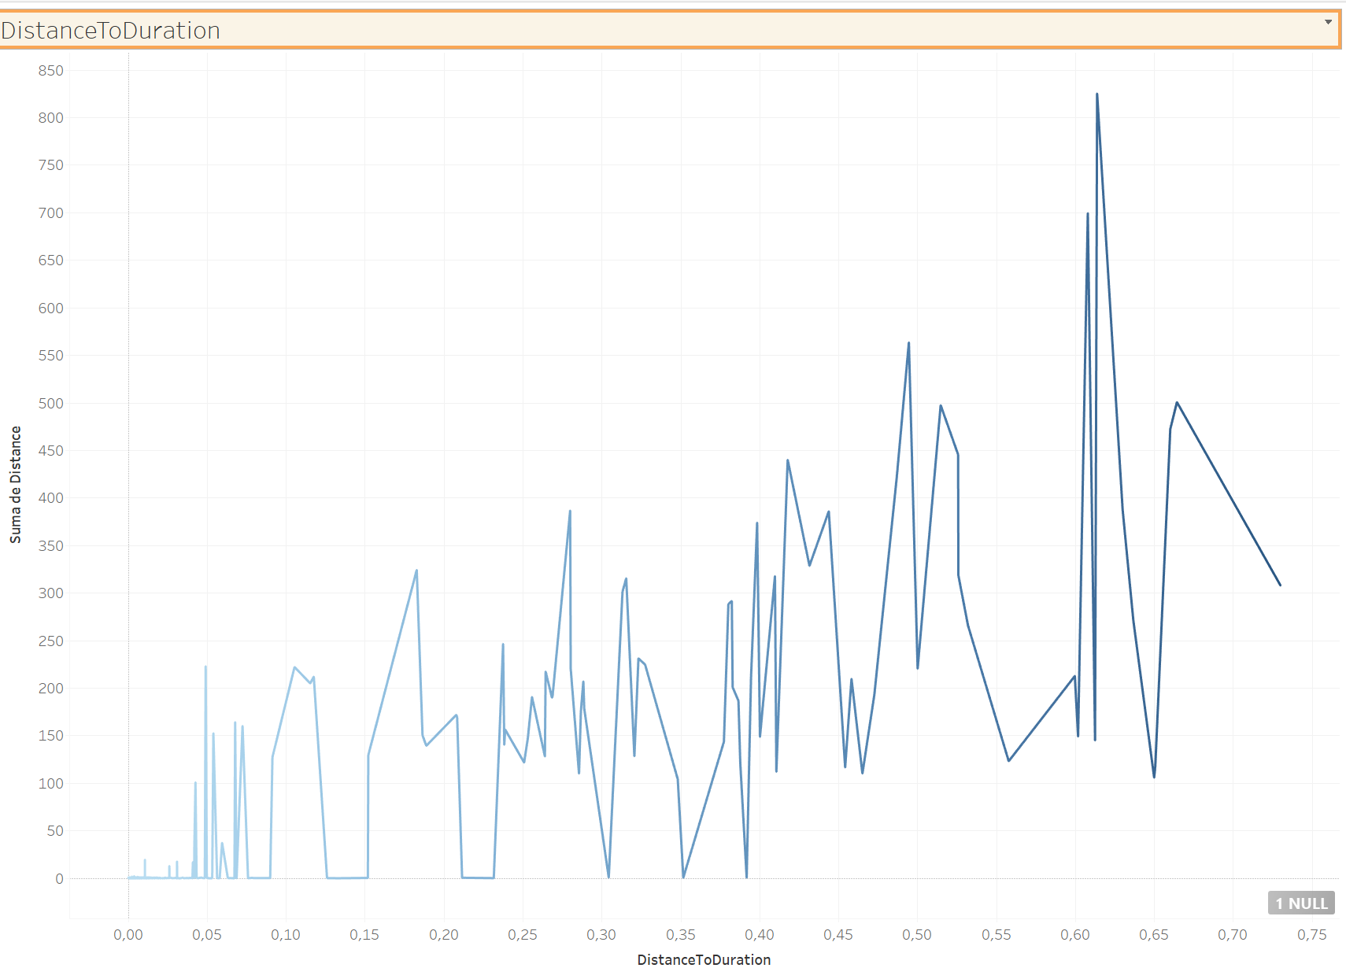

Slide 17
Let’s understand the scope and distribution various dimensions within the dataset. Calculate the average, median, and the first & second standard deviation of the mean for the following measures:
duration
distance
passenger counts
duration-to-distance ratio
price

Slide 18
Answer Slide
* Duration: Media: 962.2 Mediana: 662 1st Stand.Deviat.: 5.85 2nd Stand.Deviat.: 5.85 * Distance: Media: 0.78 Mediana: 0.74 1st Stand.Deviat.: 5.76 2nd Stand.Deviat.: 5.62 * Passenger Counts: Media: 1.66 Mediana: 1.0 1st Stand.Deviat.: 1.31 2nd Stand.Deviat.: 1.34
Duration to Distance:
Media: 26.24
Mediana: 384.5
1st Stand.Deviat.: 2.27
2nd Stand.Deviat.: 2.21
Price:
Media: 4.83
Mediana: 3.33
1st.Stand.Deviat.: 2.92
2nd Stand.Deviat.: 2.97

Slide 19
Flying cars may have to have to be a lower weight for efficiency & take-off. Or you may just decide to leverage mini-copters for your initial MVP.
Create a histogram that visualizes the number of total rides grouped by passenger counts to analyze the potential market volume of low passenger pickups (1-2 passengers).

Slide 20
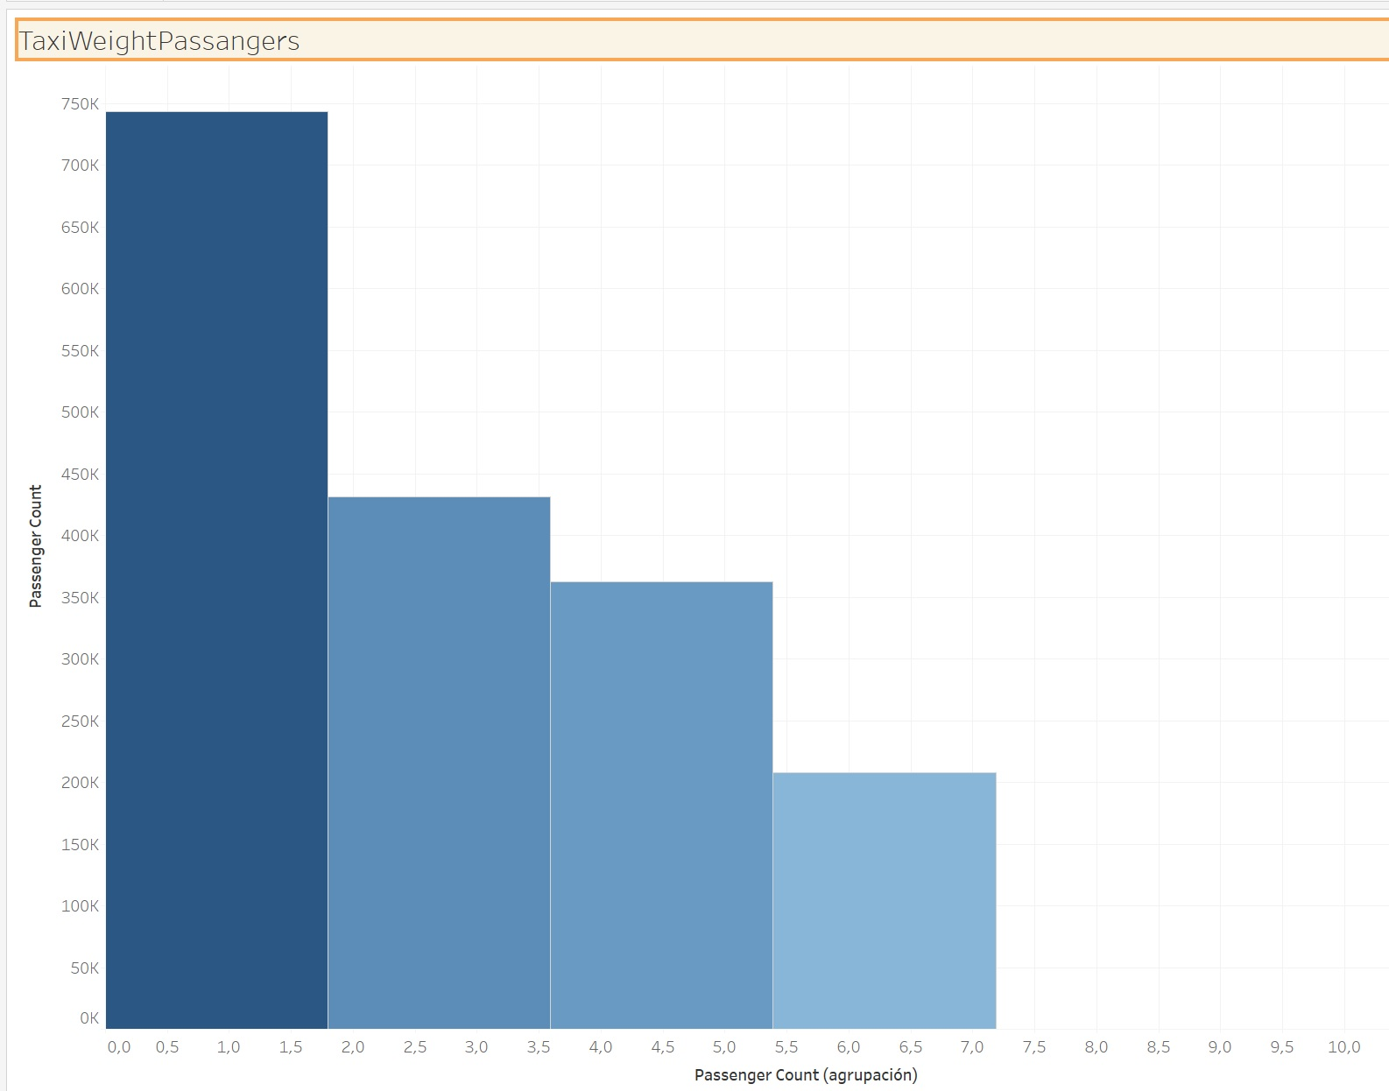
Answer Slide

Slide 21
For the initial MVP launch (& most likely GA), we have a finite amount of monetary resources to build Flyber pick-up / drop-off nodes. We’ll need to be strategic on where we’ll place them:
Which neighborhoods/zip codes tends to experience a relatively higher density of pick-ups?
Which neighborhoods/zip codes tends to experience a relatively higher density of drop-offs?
Which neighborhoods/zip codes tends to have the highest duration-to-distance ratios, based on pick-up?
Which neighborhoods/zip codes tends to have the highest duration-to-distance ratios, based on drop-off?
For any of the neighborhoods identified, are there any potential areas within the neighborhood that are optimal for flying taxi pick-up / drop-off? What makes them suitable?

Slide 22
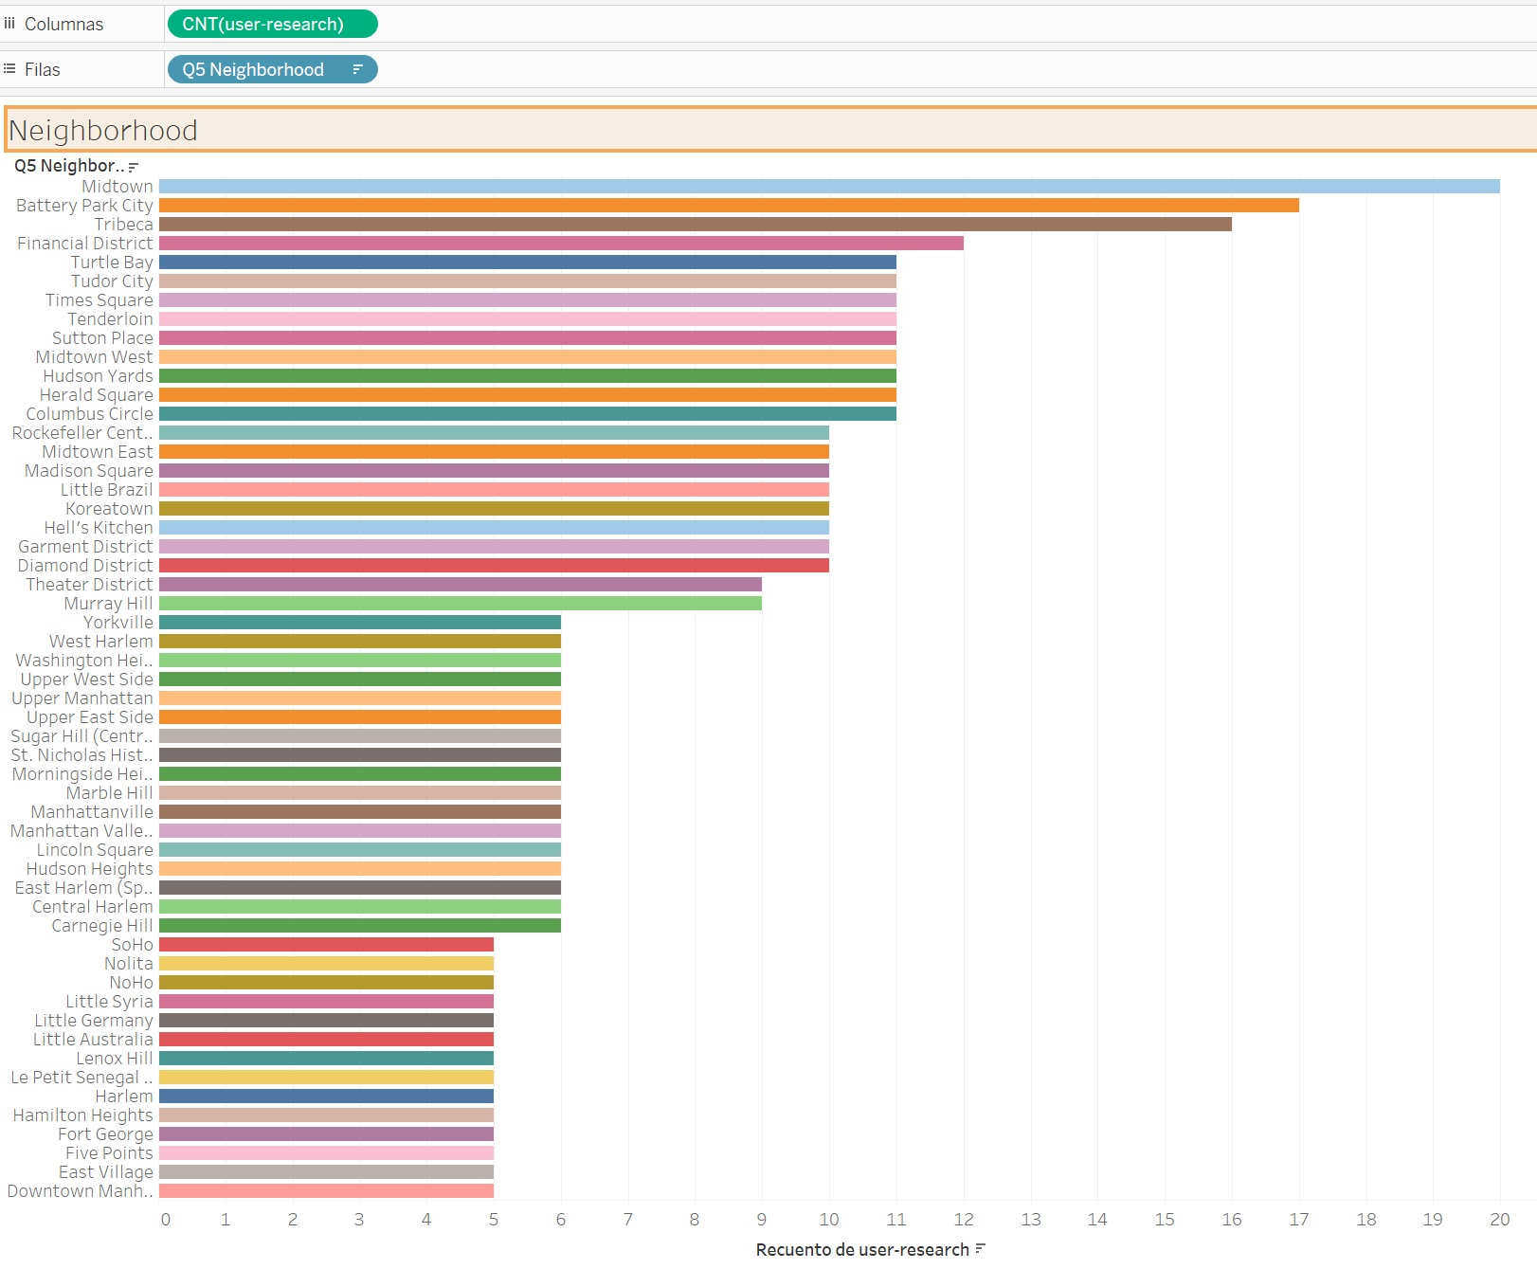
Neigborhoods PickUps:
D

Slide 23
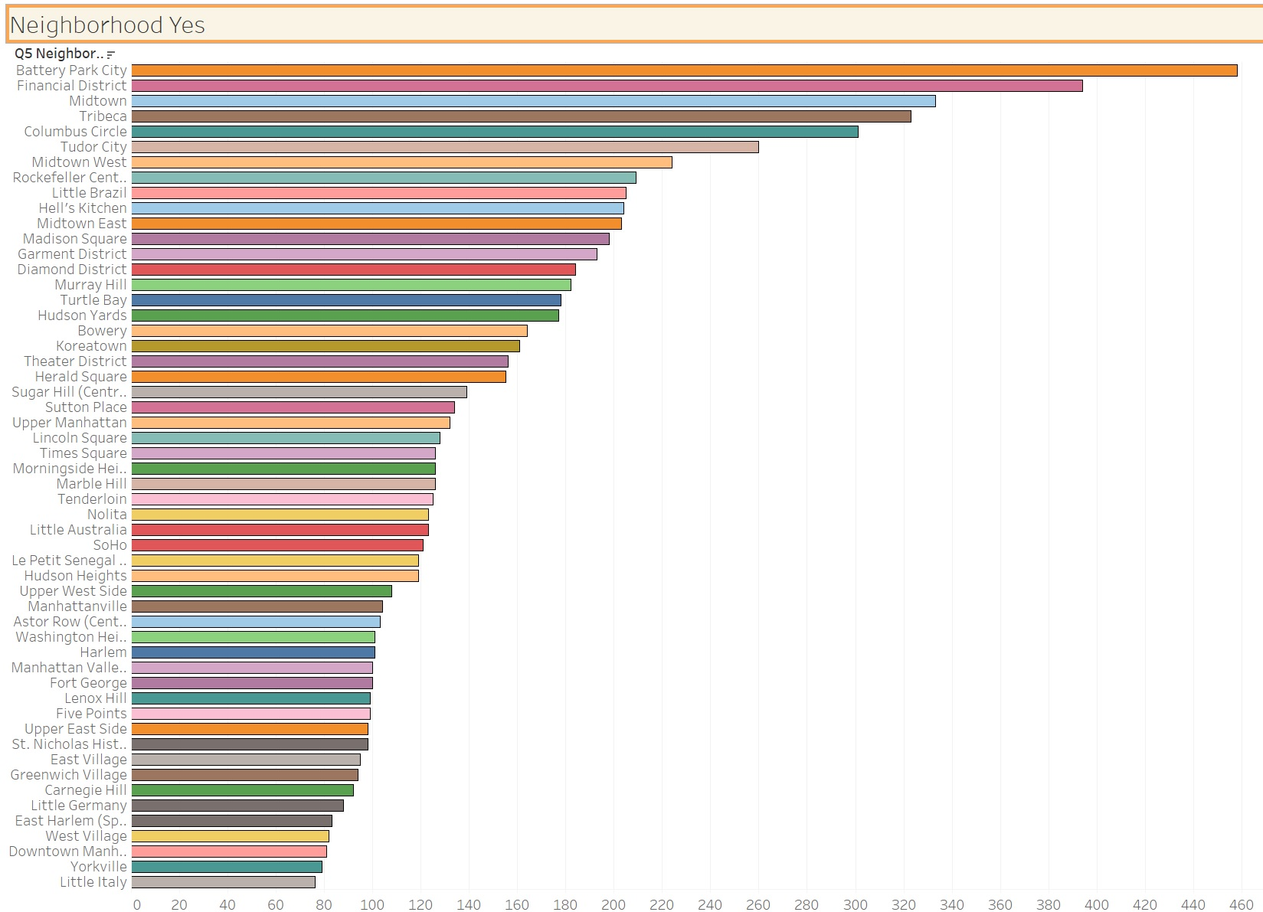
Neigborhoods OK FlyingTaxis:

Slide 24
It may not make operational sense to have the service running 24/7, for now.
What times throughout the day experience relatively higher volumes of ride pick-ups?
What days throughout the week experience relatively higher volumes of ride pick-ups?
Pinpoint any periods throughout the year that experience trend fluctuation or seasonality around ride pick-up volumes. This will help us in our post-launch analyses to determine if any spikes or dips were influenced by seasonality or through actual feature adoption/regression.

Slide 25
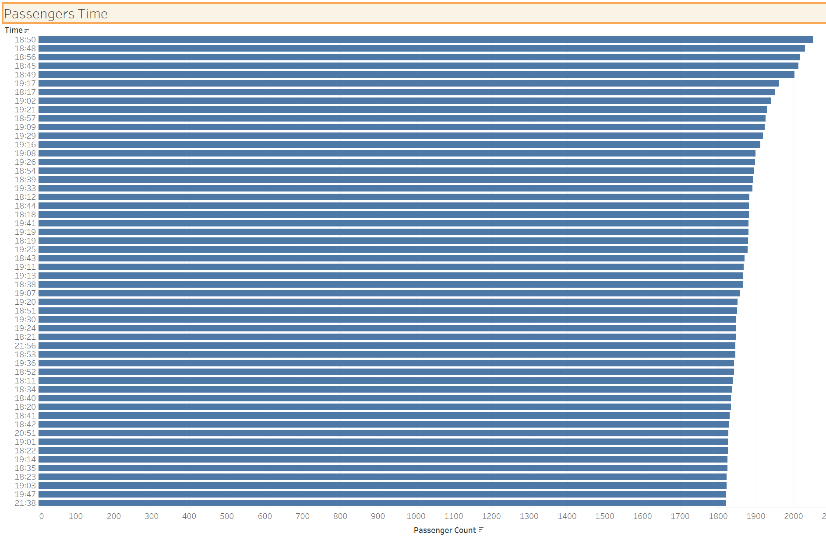

Slide 26
You and the user research team ran a quantitative survey on existing taxi and/or rideshare users in New York City to determine sentiment around potentially using a flying taxi service.
Dive into the survey results dataset in order to extract insights from explicit feedback.
Upload this dataset into Tableau Online or a SQL database (the classroom contains a workspace with the data for you as well).

Slide 27
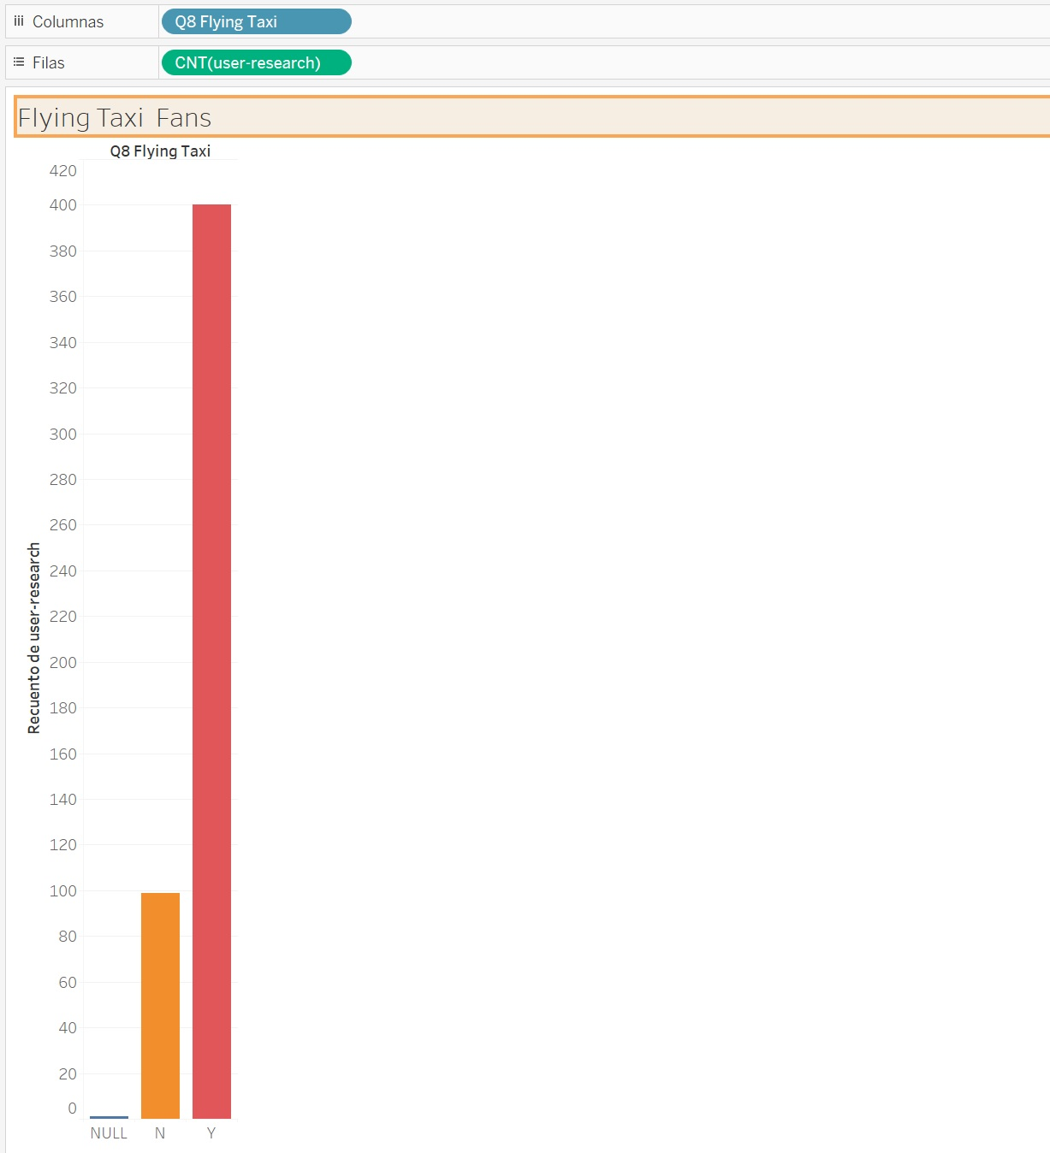

Slide 28
Ensure the fields are parsed correctly, field headers are included in the first row of the CSV.
Question schema:
Q1 - What is your email?
Q2 - What gender do you identify as?
Q3 - What is your age?
Q4 - What is your annual income? (income bands)
Q5 - What neighborhood do you reside in?
Q6 - Do you currently use taxis? (Y/N)
Q7 - Do you currently use ridesharing services? (Y/N)
Q8 - Would you use a flying taxi service, if such a concept existed? (Y/N)
Q9 - If yes to Q8, how much would you be willing to pay per mile for such a service? (USD)
Q10 - If no to Q8, what is the reason?

Slide 29
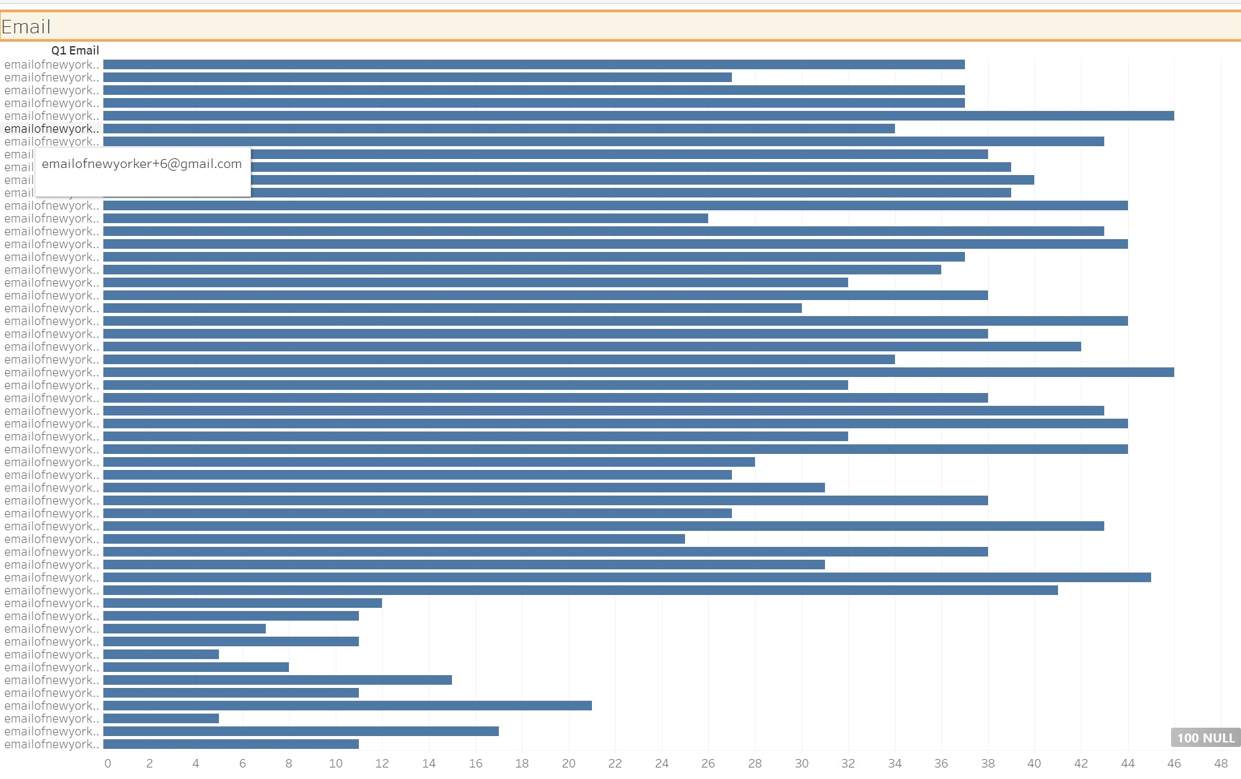

Slide 31
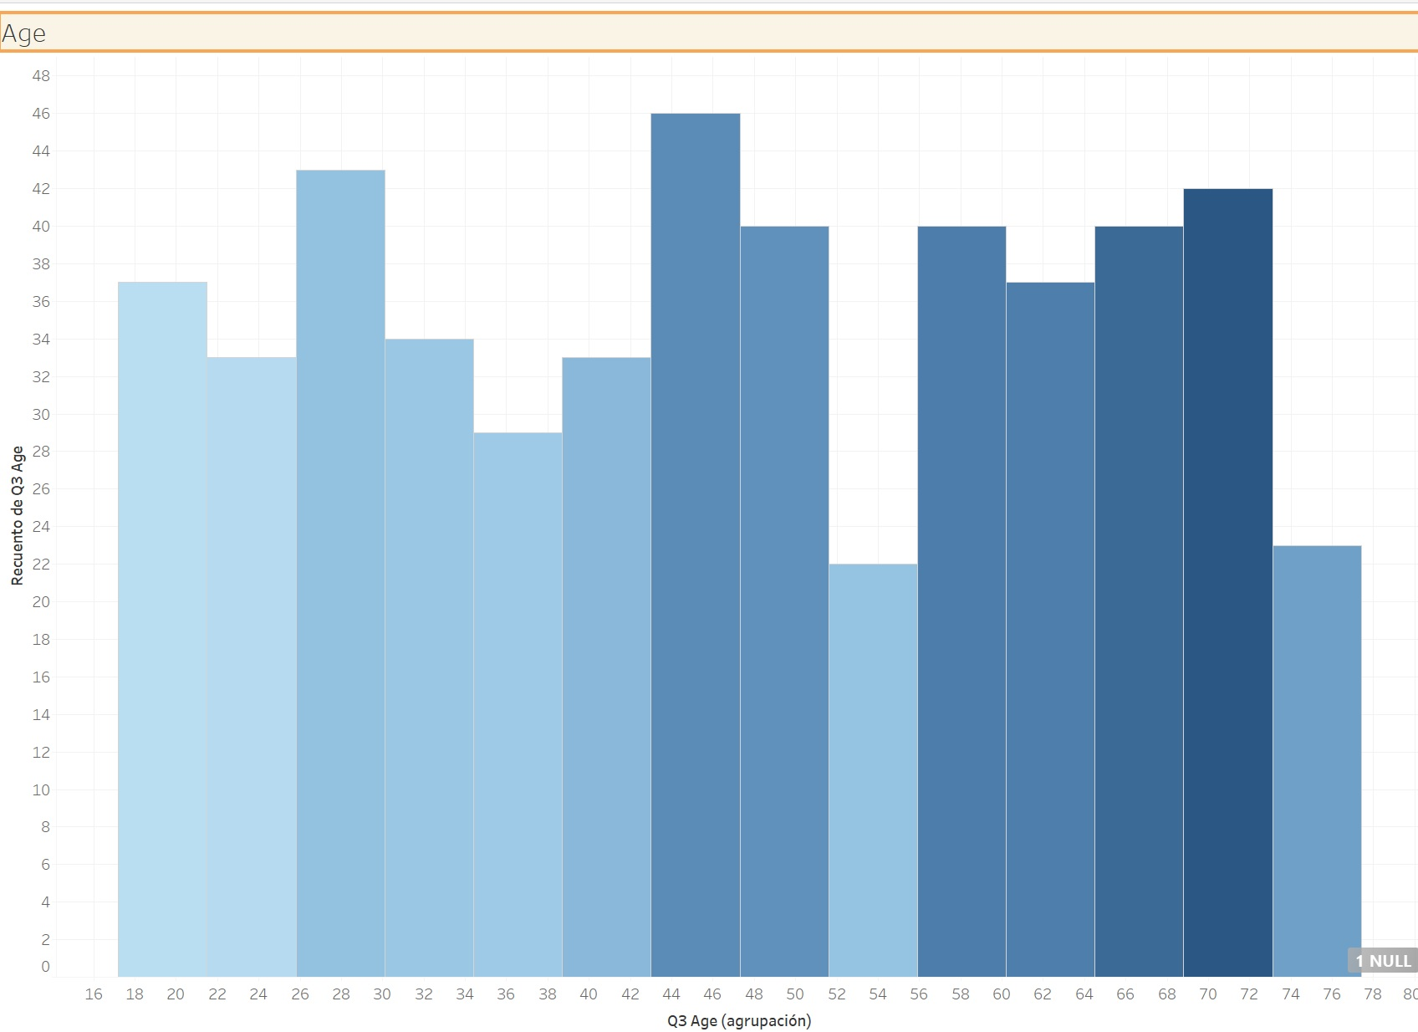

Slide 34
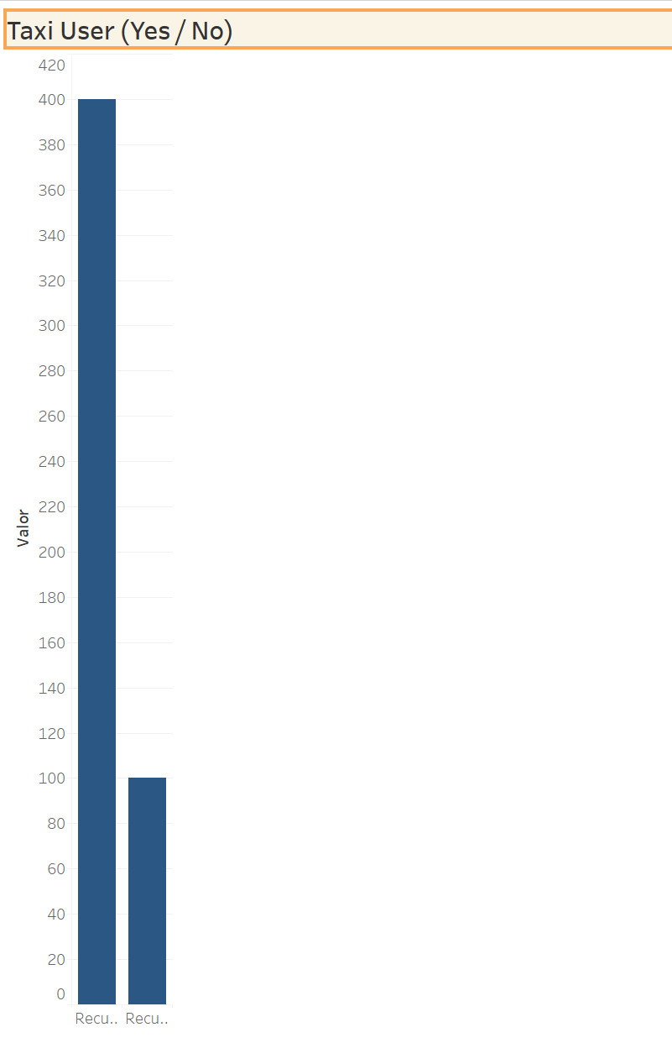

Slide 35
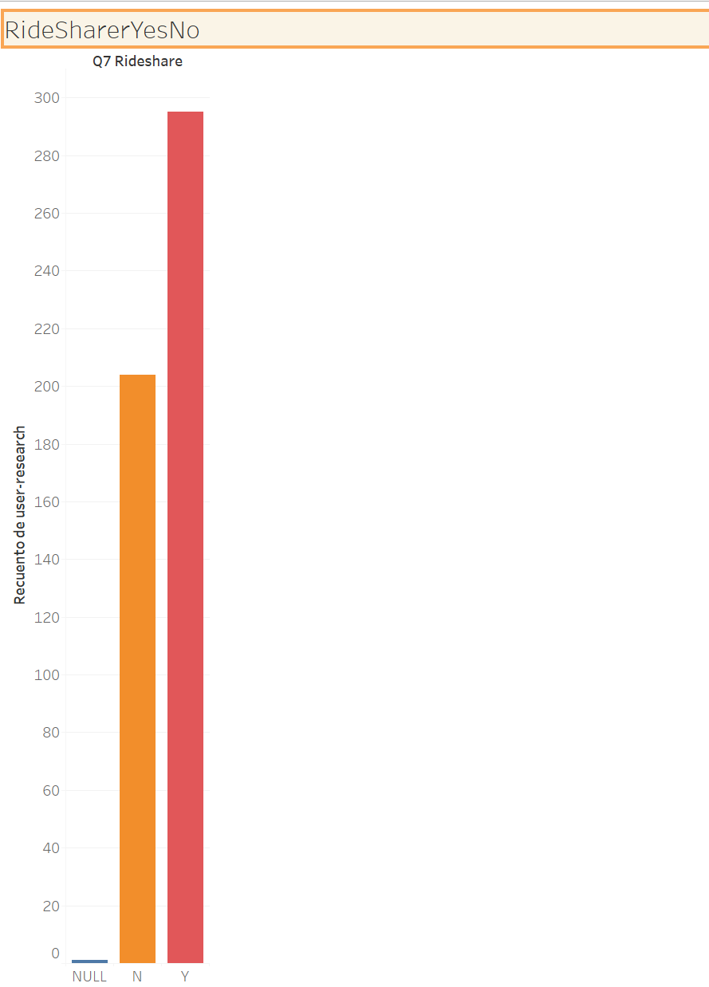

Slide 36
To inform our future product marketing efforts, we’ll want to extract the following:
Is there an inclination of better Flyber adoption based on gender, age, income level, or neighborhood of residence?
What is the distribution of potential price per mile based on gender, age, income level, and neighborhood of residence?
What is the different personas/segments of negative sentiment towards not using a flying taxi car service?

Slide 37
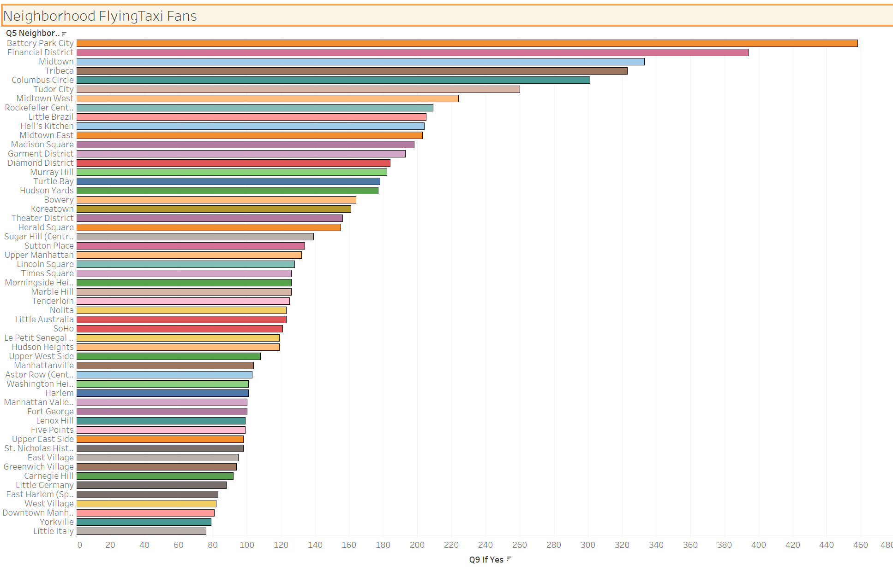

Slide 38
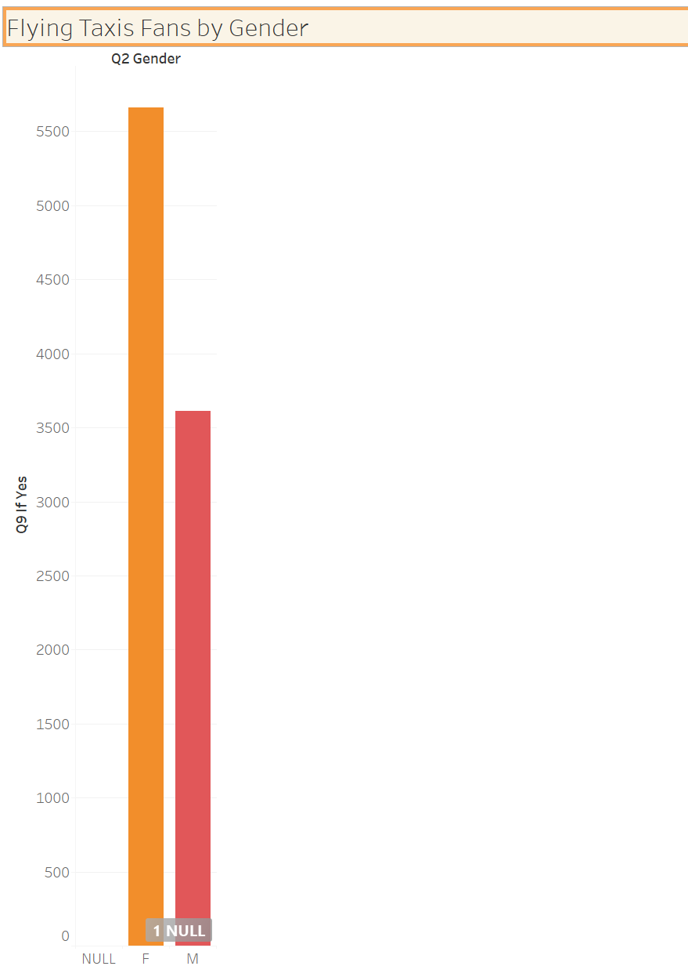

Slide 39
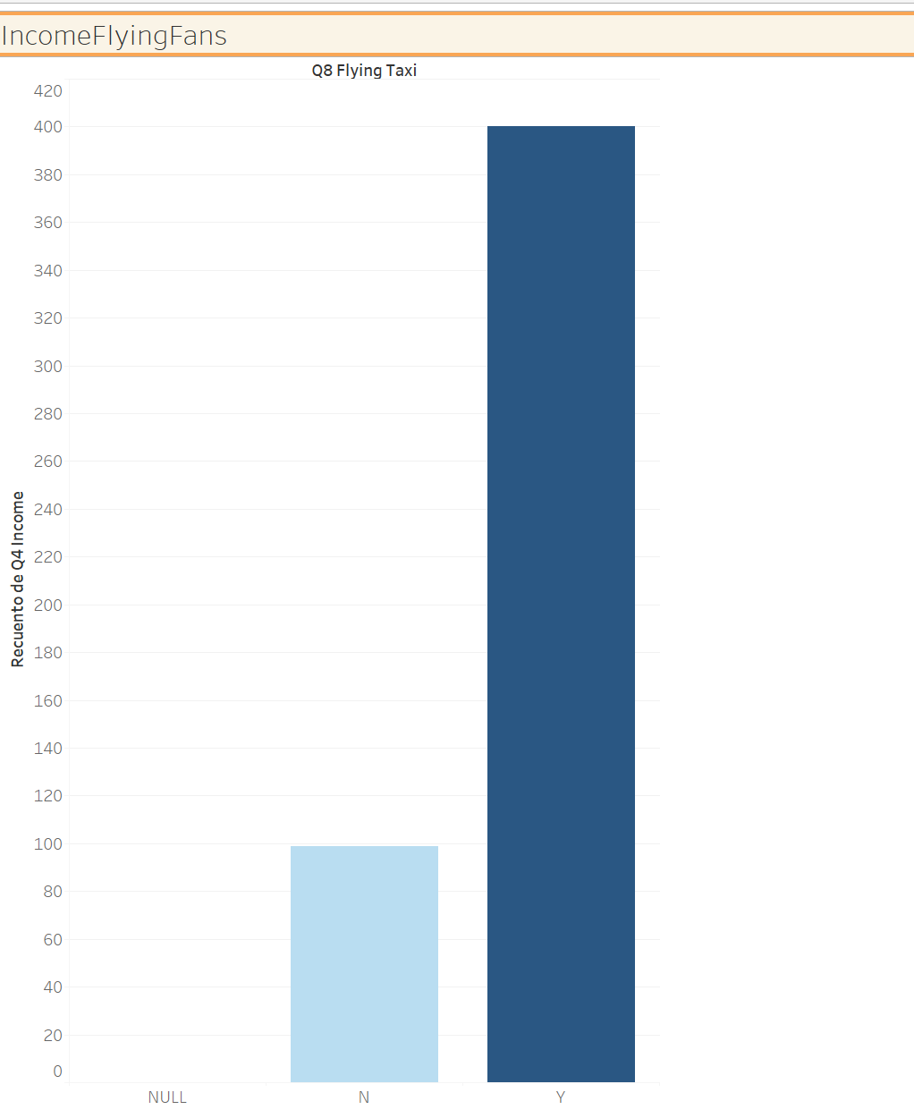

Slide 40
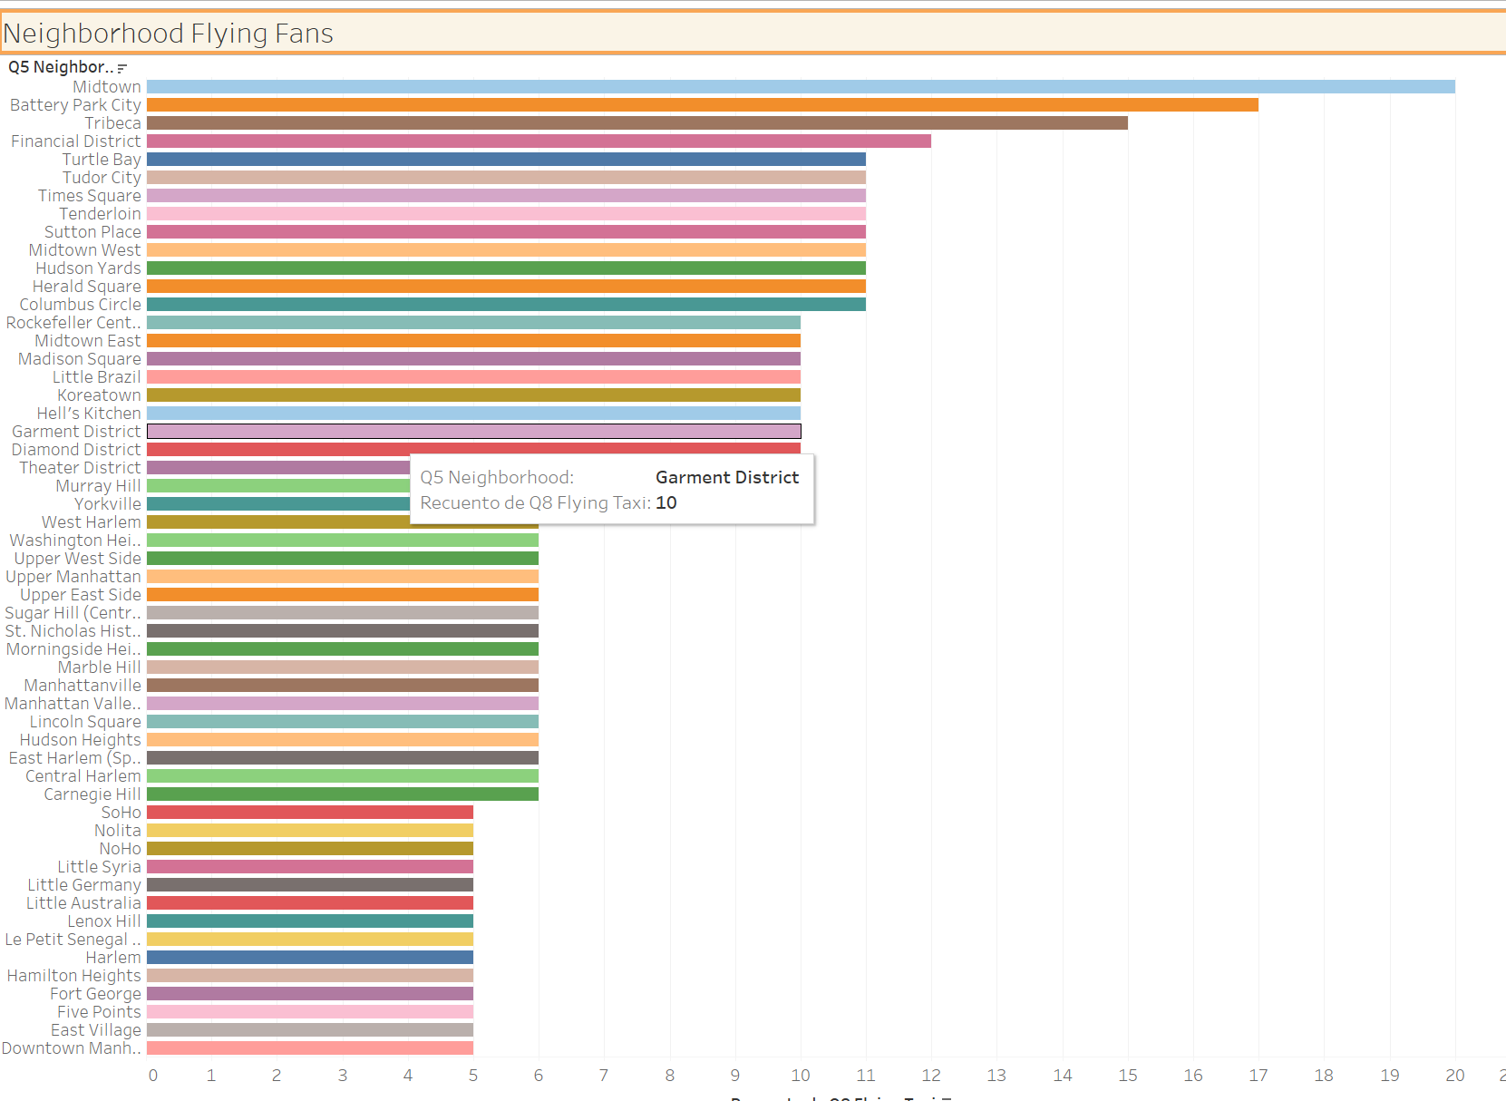

Slide 42
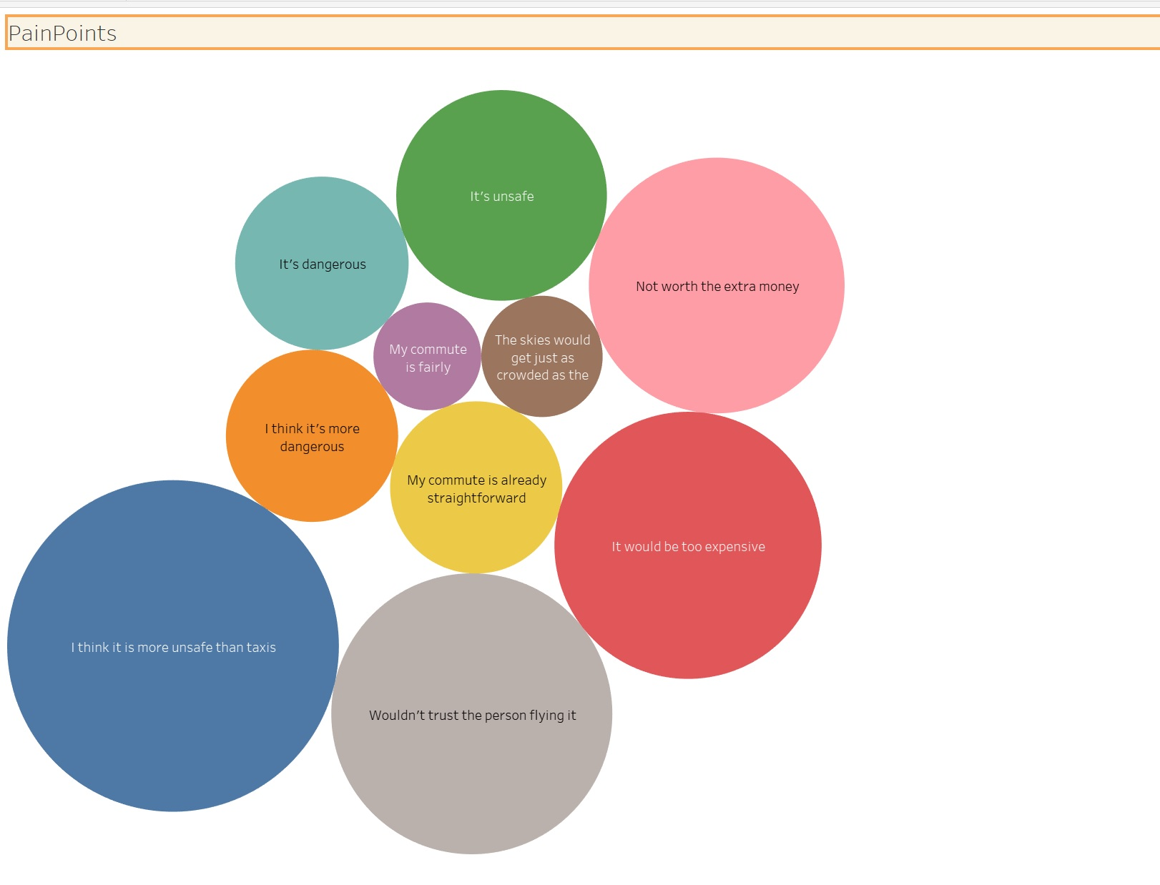

Slide 43
Hooray! End of Section 1.

Slide 44
Section 2: Proposal Synthesis

Slide 45
Identify a product objective for Flyber's launch. Your product objective will guide your KPIs, so identify what Flyber should optimize for. Your objective should be centered around one the following focus areas:
User Acquisition
User Engagement
User Retention
Profitability
Explain your reasoning. Include both why you feel your focus area is more relevant than the others for Flyber at this time of the product development cycle.

Slide 46
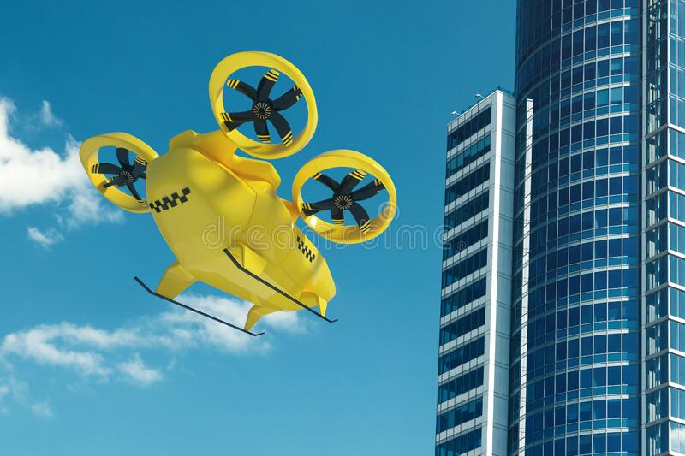
Product Objective:
* User Engagement :
https://www.dreamstime.com/photos-images/flying-taxi.html
Taking into account Flybers almost has started its activities, and it is a brand new disruption on the no-existing market, the company cannot be absolute sure about the future Company`s success. Thus, it will have to be fully aware of all the nuts and bolt about its users, knowing that for the long consumer segment of old people, still active, will be surely afraid of picking up these new taxis to travel, although it might be for short distances.
On this step of developing for Flybers, company has to get that users find value in a product or service.
That is why we think that User Engagement has to be the main topic on this period.
Engagement can be measured by a variety or combination of activities such as downloads, clicks, shares, and more. Highly engaged users are generally more profitable, provided that their activities are tied to valuable outcomes such as purchases, signups, subscriptions, or clicks.
Apart from that, User engagement is highly correlated with overall profitability. By an attractive and well designed WebPage, Flyber can track user attention that is a finite resource and if users choose to spend their time on a particular app or site, showing attention and likely interest, and they’re signaling that they find value in it. This allows the company also to make money from the product or service with ads, subscriptions, or sales. Highly engaged users are more likely to buy, return, and share the product or service with friends (word to mouth in this case). Product and marketing teams that measure user engagement can use product analytics o understand the factors that contribute to higher engagement.

Slide 47
Formulate 3-5 Key Performance Indicators (KPIs), to measure if the product is heading towards the right direction based on your objective

Slide 48
KPI:
* Monthly Active Users (MAU): number of unique users per month
* Control variant: The group that receives the current experience
* Flying Participation %: Taxi Flyers fans / City habitants (monthly)
* New Users: (Users Qn – Users Qn-1) / Users Qn-1
* User Churn: Users Qn – Users Qn-1

Slide 49
Create hypotheses around what thresholds your KPIs would need to hit in order to determine success

Slide 50
It has been planned to be about 15.000 users, who might take the flying taxi over 2 times / week, at least.
* Control variant: For tagged demographic groups, it has been thought about: male/female, 35 / 65 years old, 50,000 / 70,000$ year, liviing in a down town área, mostly. * Flying Users Participation %: Company`s executives discussed about having about 1,5 / 3% monthly from citizens in NY would be considered successful and profitable. Counting with 37% of flying taxi users from taxi standar users / monthly would be formidable in the first two years. * New Users: CFO estimated that a 15% worked out Quaterly as new users is the targeted Budget. * Users Churn: The objective is placed among 0.45% / monthly for users, but executives are making their best to reduce this number.
KPI forecasted:
Monthly Active Users (MAU):

Slide 51
As the product manager, you make decisions based on the insights you extract, we’ll need to know the feature set we’ll include in the MVP to measure viability, while keeping operational expenditure under control:
What times/days of operation should the service run for?
How many pick-up / drop-off nodes should we have?
Where should the nodes be located?
Should we initially use copters or homegrown hardware?
Should the pricing be fixed or dynamic? At what rates?

Slide 52
Answer Slide
* What times/days of operation should the service run for? Up to the day of the week, Directors agreed that the flying taxis schedule on average might be: Friday to Sunday (01:00): 500 taxis on air (06:30 – 00:30) Other days: 350 taxis (07:00-00:00). This plan is projected for the first two years. * How many pick-up / drop-off nodes should we have? On weekends the minimum pickups is thought over 578 daily, and for the other days, 453. * Where should the nodes be located? It has been calculated that they should be placed in Battery Park City, Financial District, Midtown, and fkTribeca. * Should we initially use copters or homegrown hardware? For the first steps (two years) it has been planned to use copters to easy the service for users. * Should the pricing be fixed or dynamic? At what rates? As a catching-offer, Marketing Dpt. Suggested dynamic pricing for the first ten months, in order to make flying taxis famous and spread word to mouth effect among users to share its qualities over likely future users. Free pickup, and seven free minutes was considered to be a Good plan to reach what is mentioned before.

Slide 53
Determine the MVP sample size & time period allotted estimated to come to a conclusion on your hypotheses.

Slide 54
MVP metrics:
Collection of Features:
Small electric battery
Passenger max.espace: 2 people
No extra equipment
Standard taxi models
No long distances allowed
Max.30 mts on air
Max.speed: 90miles/hour
Time period: 1 year and a half
Test Zones: Battery Park City, Financial District, Midtown

Slide 55
Create an instrumentation plan for the events you need collected and logged, in order to be able to physically measure your KPIs.

Slide 56
Instrumentation Plan:
Events:
- User adquisition:
Users signed-in
- App bookings
- Total Drops-in daily
- Total Drops-off daily
- Passengers daily
- City area drops-in daily
- Time-bands drops-in daily

Slide 57
Create a qualitative feedback survey questions for users after their ride, to further understand and optimize the product for future iterations.

Slide 58
Survey Questions:
How did you know Flyber?
Have you ride our flying taxis?
What city are are you living in?
What is your income band yearly?
What is your gender and age?
Do you use Flyber alone or accompanied?
What is your experience with us?
Will you use it again?
How often would you use Flyber?
What are you the best pros with Flyber?
Any feature to be improved?
Do you find expensive the invoice payed?
Will you travel with us once more?
Why wouldnot you use our Flyber?

Slide 59
Summarize everything you have learned into your final proposal
Identify the target population. Why did you select that target population? What are their pain points?
Create a product proposal containing claim, evidence, estimated impact, and risks
Claims should be backed by quantitative evidence, impact should assess market needs/benefits
Risks involve any known unknowns that we’ll still need to monitor post-launch
State cross-functional stakeholder teams that will need to be involved

Slide 60
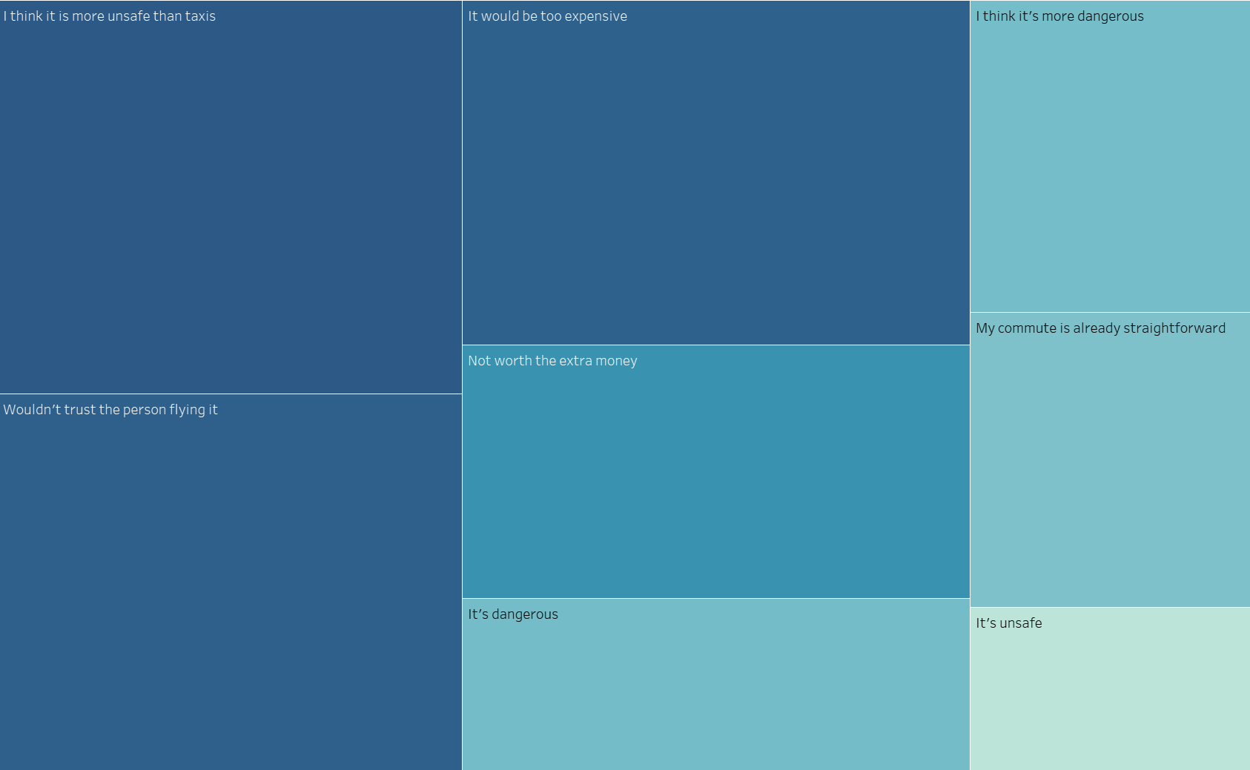
Target population: Aged 65 / 85 – Pain Points:
It has been selected this target population due to the fact they are likey more feared about using disrupting services never used before, and, on the other hand, they have more money to be wasted, having saved extra money during their worker life. It is a key consumers segment

Slide 61
Target population: Aged 18 / 85 – Pain Points

Slide 62
Claims backed up with evidences:
* Danger about flying:
Labs of Flyber shows a signifance measure of 0,7% of risk-probabiliy according to figures addressed to country Transportation authorities (cTA) who assured this confirmation last 05/11/2020. Futhermore, tests were 1,528
in a row and no significative variance was observed from average on this population.
* Expensive prices: Not only prices are going to be much more expensive than the standard ones, but also users will benefit from shorter time for the same distances because of no traffic congestion, what leads to a saving for user’s pocket after all.
* More unsafe than taxis: Future taxi drivers are going to be obligued to pass exams to obtain the Flying Taxis Licence.
This Licence will need to be renewed by qualifications exams yearly to allow taxi driver to perform his activity.
* Involved Risks: For these risks above mentioned, and future ones unknown currently, Flyber guarantees the most accurate examination of them, and assures to find the earliest and safest solution to them.
Stakeholder Teams: Flyber is so proud of counting with the next professional assistance teams among its staff:
- Mechanical equipment
- Traffic observers
- Customers assistance
- Customers lawyers
- Health caregivers
- Driver learning classroom
- Meteorologists
- Smart City experts

Slide 63
Pain points - What are the existing issues and/or pain points that they are facing? Target users - Who are the users that you are targeting to service / build products for? User impact - What is the potential impact of these proposed solutions to solve the users’ pain? Market impact - How does the proposed solutions fit in with the existing solutions in the market? How do you expect the proposed solutions to shift or alter the market? For publically accessible context general market trends, Bond Capital’s Mary Meeker’s anual is an excellent resource. Business impact - What is the potential impact of these proposed solutions to the bottom line in terms of revenue, user acquisition, & user retention? Solutions - What are some of the proposed solutions to alleviate or solve the pain points we called out. This includes the high-level features you’ll be building. Also, do be sure to call out what features we will not be building.

Slide 64
Product Proposal:
PainPoints: Adversion to disruptive technology – Fear of unknown services – Lack of regulation – Unfair competition with taxis – High prices expected – No enough vehicles – Amateur drivers.
Target Users: Midel aged, living in Battery Park City, Financial District and Midtown.
User’s Impact: TV ads launching the pros about using the brand new solution for city transport. -Calling ecologist groups who surely will feel bliss over pollution reduction with Flyber - Hiring a famous middle-aged actor who will address no fears about using Flyber - The concern about traffic congestion matter all sort of citizens – Urgency ambulances benefited from Flyber by using its chooper will expand Flyber brand.
Business Impact: The forecasted revenue will be guaranteed by the ROI %, once total cash-in will pay costs, contributing to a 7% of profits in the medium term studied. Market studies performed on selected districts shows it - From implementing campaigns to User Acquisition will help Flyber to optimize this process. The Flyber’s efforts have been focused on optimizing the organic traffic and making organic users work harder for Flyber is one way to build a base of high-value customers. In other words, all of this brings about user retention in a medium term.
Solutions: In order to facilitate an easy and readily appliable solution to some current drawbacs, CFO’s have planned a list of proposed actions to carry out sooner than later. Among them, can be cited: extra equipment of halmets for passengers on the first rides. – Making clear how cutting-edge solutions meant a huge and benefitial impact for society – Measuring, and making it clear the effect of no pollution in health of citizens – Friendly meetings with former taxi drives and reaching terms of cooperation.
Not foreseen solution yet: Legal driving licence for Flyber’s drivers – Legal regulations for flying taxis.

